Slide 1
Incremental Decision Trees
Walter Gallego Gomez

Slide 2
Outline
Incremental learning
ID5R and ITI algorithms
VFDT algorithm
HW implementation of VFDT
VFDT with positive and unlabeled data

Slide 3
Incremental learning

Slide 4
Incremental learning
Training Samples arrive sequentially
No distinct phases of learning and operation. The system be used for classification and later refined with new training samples.
Often Real Time.
When a new training sample arrives, is cheaper to update the system accordingly than to re-build from scratch.

Slide 5
Incremental learning
Incremental learning is useful when:
The application is intrinsically sequential.
There is a huge volume of training data (stored for example in a hard disk) and it is not possible for the algorithm to evaluate it all at the same time, so it has to be presented sequentially.

Slide 6
ID5R and ITI algorithms

Slide 7
ID5R and ITI algorithms
ID5R, proposed by Paul E. Utgoff in 1989
Modification of the basic non incremental ID3 algorithm. Only works for two-classes applications.
Each time a new sample arrives, statics on each node are updated, and the current tree is restructured if necessary.
ITI, same author, 1994: Improvements on ID5R, to handle numerical attributes, Multiple classes and missing values.

Slide 8
ID5R and ITI algorithms
In Both algorithms:
Example order doesn’t affect the resulting tree. It is guaranteed that the tree is the same that would have been obtained using the ID3 algorithm.
Needs to store all examples, in leaf nodes.
In non-leaf nodes, statics are stored.
Relatively slow because restructuring of the tree may be necessary when new samples arrive

Slide 9
VFDT algorithm

Slide 10
Very Fast Decision Tree learner
VFDT proposed by Pedro Domingos and Geoff Hulten in 2000
Inspect each training sample only once. There is no need to store the samples.
The only information kept in memory is the tree itself and some statics.
The algorithm can produce trees of the same quality as batch learned trees.

Slide 11
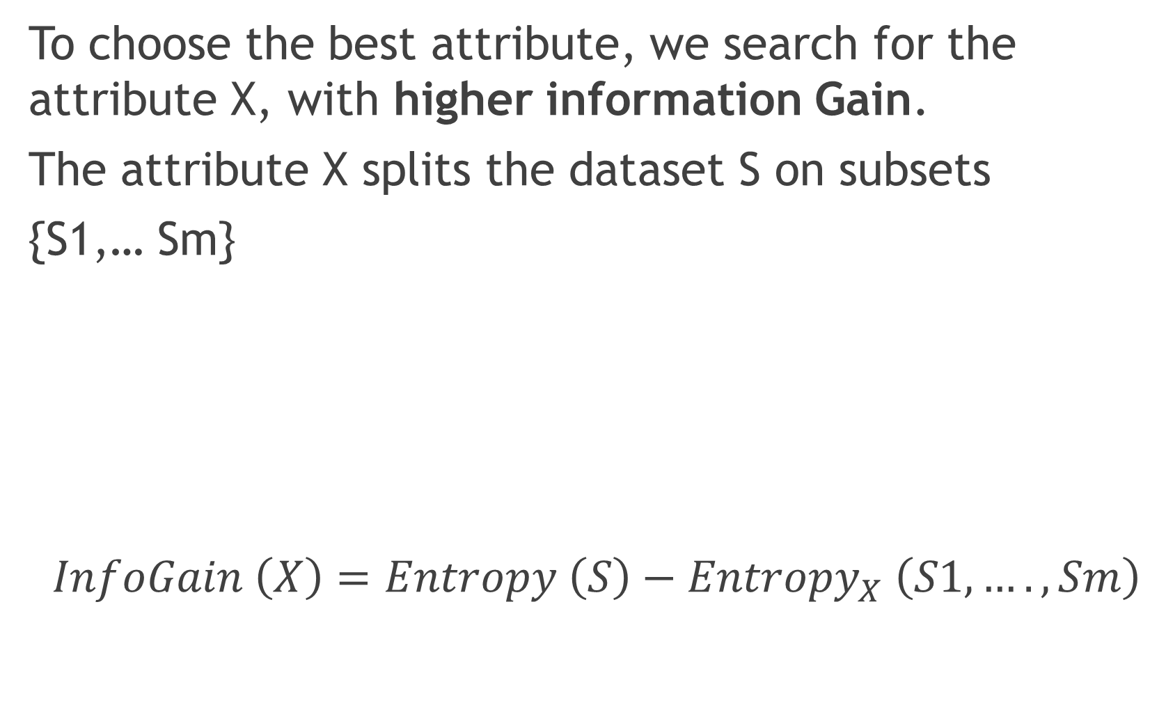
Information Gain
To choose the best attribute, we search for the attribute X, with higher information Gain.
The attribute X splits the dataset S on subsets
{S1,… Sm}
$$InfoGain \left(X\right)=Entropy \left(S\right)−Entropy_{X} \left(S1,…., Sm\right)$$

Slide 12
Information Gain
To choose the best attribute, we search for the attribute X, with higher information Gain.
The attribute X splits the dataset S on subsets
{S1,… Sm}
$$InfoGain \left(X\right)=Entropy \left(S\right)−Entropy_{X} \left(S1,…., Sm\right)$$
Information Gain for split X

Slide 13
Information Gain
To choose the best attribute, we search for the attribute X, with higher information Gain.
The attribute X splits the dataset S on subsets
{S1,… Sm}
$$InfoGain \left(X\right)=Entropy \left(S\right)−Entropy_{X} \left(S1,…., Sm\right)$$
Entropy before the split, on dataset S

Slide 14
Information Gain
To choose the best attribute, we search for the attribute X, with higher information Gain.
The attribute X splits the dataset S on subsets
{S1,… Sm}
$$InfoGain \left(X\right)=Entropy \left(S\right)−Entropy_{X} \left(S1,…., Sm\right)$$
Entropy after the split, averaged, for the subsets {S1,… Sm}

Slide 15
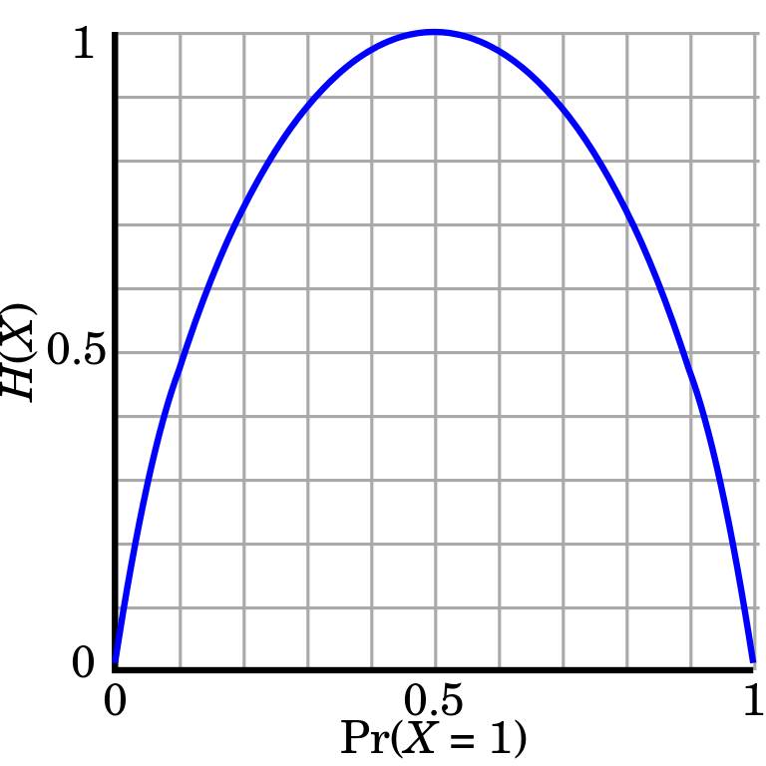
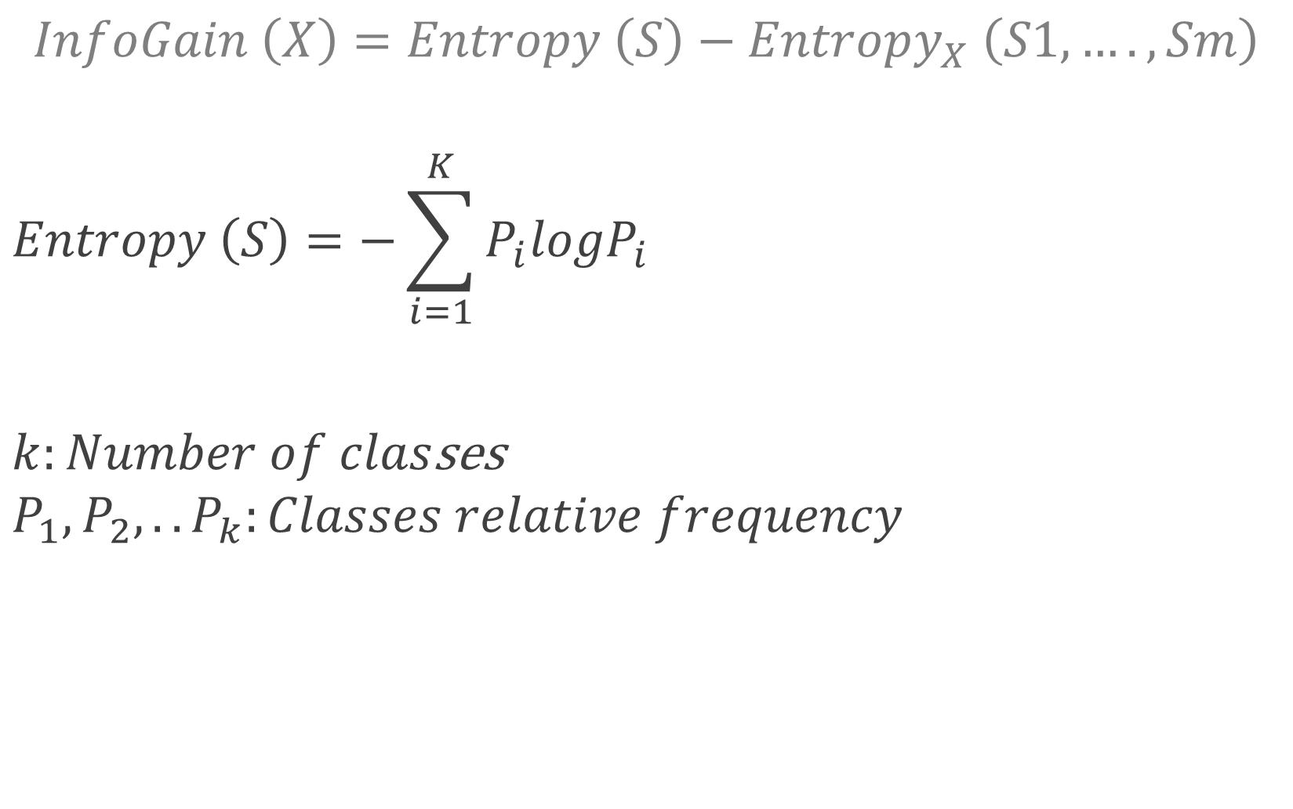
Entropy
$$InfoGain \left(X\right)=Entropy \left(S\right)−Entropy_{X} \left(S1,…., Sm\right)$$
$$Entropy \left(S\right)=−\sum_{i=1}^{K}{P_{i}logP_{i}}$$
$k:Number of clas$ses
$$P_{1}, P_{2}, .. P_{k}:Classes relative frequency$$

Slide 16

Averaged Entropy of subsets.
$$InfoGain \left(X\right)=Entropy \left(S\right)−Entropy_{X} \left(S_{1},…., Sm\right)$$
$$Entropy_{X} \left(S_{1},…., Sm\right)= −\sum_{i=1}^{m}{\frac{n_{i}}{n}Entropy(S_{i})}$$
$$n:Number of samples on S.$$

Slide 17
Hoeffding bound trees
How can we find the attribute with the Highest information Gain for a node without examining all the training data?
If the algorithm is receiving samples sequentially, how many samples are required to evaluate the infoGain?
For each leaf-node, read samples sequentially, until I can choose the best attribute for a split with enough confidence. Future samples will be used in nodes downstream.

Slide 18

Hoeffding bound trees
Hoeffding bound: With a probability(confidence) $1−δ$, the true mean of a random variable of range R, will not differ from the estimated mean after n independent observations for more than:
$$∈ = \sqrt{\frac{R^{2}\ln\left(\frac{1}{δ}\right)}{2n}}$$

Slide 19
Hoeffding bound trees
Hoeffding bound: With a probability(confidence) $1−δ$, the true mean of a random variable of range R, will not differ from the estimated mean after n independent observations for more than:
$$∈ = \sqrt{\frac{R^{2}\ln\left(\frac{1}{δ}\right)}{2n}}$$
The larger n, the lower the error.

Slide 20
Hoeffding bound trees
Hoeffding bound: With a probability(confidence) $1−δ$, the true mean of a random variable of range R, will not differ from the estimated mean after n independent observations for more than:
$$∈ = \sqrt{\frac{R^{2}\ln\left(\frac{1}{δ}\right)}{2n}}$$
The larger the range, the larger the error.

Slide 21
Hoeffding bound trees
Hoeffding bound: With a probability(confidence) $1−δ$, the true mean of a random variable of range R, will not differ from the estimated mean after n independent observations for more than:
$$∈ = \sqrt{\frac{R^{2}\ln\left(\frac{1}{δ}\right)}{2n}}$$
The higher the confidence, the higher the admitted error.

Slide 22

Hoeffding bound trees
The random variable being estimated is:
$$∆G=G\left(X_{a}\right)−G\left(X_{b}\right)$$
$G:Info Gain \left(or some other metric\right)$
$Xa:Best attribute$
$X_{b}:Second best attribute$
If we can estimate with confidence that $∆G$ is positive, then $X_{a}$ is indeed the best attribute.

Slide 23

Hoeffding bound trees
To estimate, make n observations until:
$$\overline{∆G}=\overline{G\left(X_{a}\right)}−\overline{G\left(X_{b}\right)}> ∈$$
With this, we know that, with a probability of $1−δ, X_{a}$is the best attribute.
For example, if $\overline{∆G}=0.3$ and $∈=0.1$, it means that $G\left(X_{a}\right)$ is at least 0.2 larger than $G\left(X_{b}\right)$

Slide 24

Hoeffding bound trees
When a new training sample arrives, it traverses tree until it reaches a leaf node.
In the leaf, statics about previously seen samples are stored.
If the samples do not belong to the same class: Gain info for each attribute and the Hoeffding error are recomputed.
If the condition $\overline{∆G}>∈$ holds:
the leaf is transformed into a node, using $X_{a}$ as attribute.

Slide 25
VFDT Hardware implementation

Slide 26
Acceleration of Data Streaming Classification Using Reconfigurable Technology – 2015
FPGA-based architecture for streaming data processing. The implemented architecture maps the VFDT algorithm, on a reconfigurable platform with very promising performance results.
• This is the first hardware-based architecture to build the VFDT data streaming classifier on a high-end FPGA platform.
• The architecture takes advantage of the fine-grained and the coarse-grained parallelism that reconfigurable hardware can offer.

Slide 27
Acceleration of Data Streaming Classification Using Reconfigurable Technology – 2015
The training process is a much more computationally intensive process than the classification one.
“The most time consuming part of the algorithm is the computation of the split suggestions at the leaves. Thus, we focused on accelerating the leaf operations by mapping these operations on reconfigurable technology.”

Slide 28
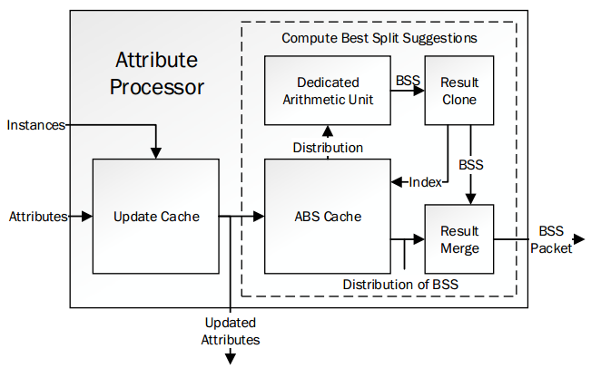
Attribute processor
Updates the statics of a single node when a new instance arrives and calculates best split suggestions.

Slide 29
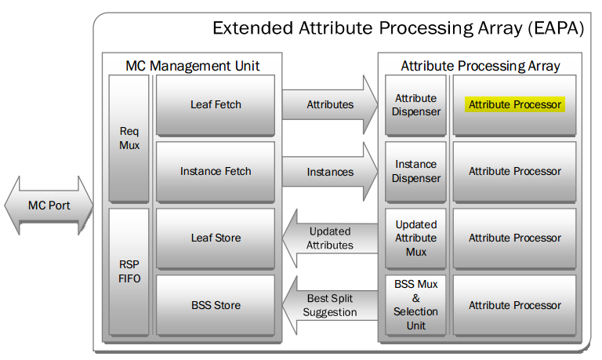
Attribute processor
It consists of a series of parallel Attribute Processing Modules.
The DMA modules residing in MCMU feed APA with attributes and instances while the dispensers deliver the data to the Attribute Processors

Slide 30
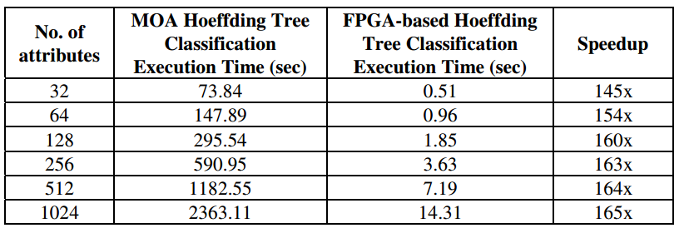
Acceleration of Data Streaming Classification Using Reconfigurable Technology – 2015
Some results reported by the authors:

Slide 31
VFDT with positive and unlabeled data

Slide 32
Learning very fast decision tree from uncertain data streams with positive and unlabeled samples– 2012
Semi-supervised learning.
The idea is to modify the CVFDT (Concept adapting) algorithm, to make possible the learning from positive and unlabeled samples.
It works for applications with only two possible classes: “Positive” and “Negative”. Some of the training samples have been labeled as positive. The others are unlabeled.

Slide 33
Learning very fast decision tree from uncertain data streams with positive and unlabeled samples– 2012
“ We argue that, in many practical situations, elements of the target concept may be abundant and cheap to collect. For instance, consider one diagnosis of diseases: in order to obtain an fully-labeled examples, it is necessary to systematically detect the disease on a representative sample of patients and this task may be quite expensive (or impossible). On the other hand, it may be easy to collect the medical files of patients who have the disease. Also, unlabeled data are any pool of patients possibly having the disease.”

Slide 34
Learning very fast decision tree from uncertain data streams with positive and unlabeled samples– 2012
“A series of experiments on both synthetic and real-life dataset show that the proposed puuCVFDT algorithm has strong capabilities to learn from uncertain data streams with positive and unlabeled samples and tackle concept drift. Even when only 10% of the samples in the stream are positive, the classification accuracy of puuCVFDT is still very close to that of CVFDT”

